Slide 1
I210 Information Infrastructure
Lab 7

Slide 2

Topic - Exceptions
When we program, we often begin by writing code for one case, or one example, because that is how we can envision what needs to be done.

Slide 3
Topic
But not all input is the same.
We have to assume that sometimes what we get from a user or read in from a file or what is passed to our functions won’t be what we expected in general.
We need a way to catch those errors and handle the issue so our program will not stop working.
That’s why today’s focus in on EXCEPTIONS.

Slide 4
Quick Review – Catching Exceptions
try:
file = open("number.txt", "r")
num = int(file.readline())
except IOError:
print("File not found!")
except ValueError:
print("number.txt doesn't have an integer.")
except Exception as e: #catches any other exception!
print("Python's error message:", e)

Slide 5
Quick Review – Catching Exceptions
We can also add an else clause:
try:
num = int(input ("Enter an integer: "))
except:
print("That wasn't an integer.")
else:
print("Integer entered.")
→ Note: the else will run if the try is successful.

Slide 6
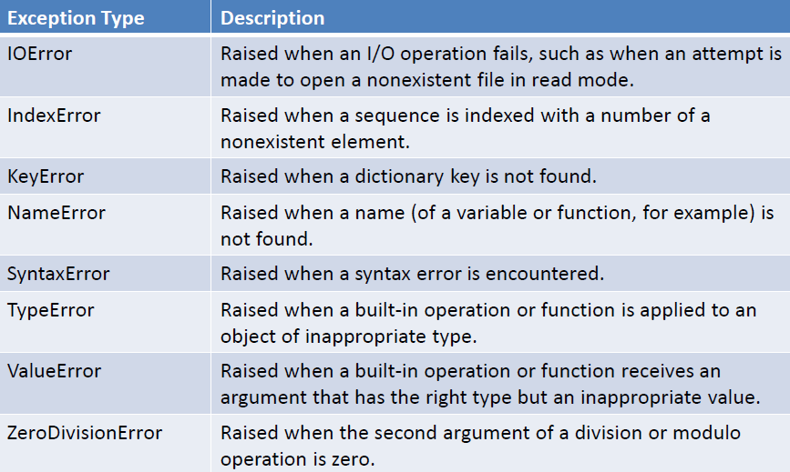
Quick Review - Exception Types

Slide 7
When to Catch Errors?
Q: When should we try to catch exceptions?
Opening a file
When converting from one type of data to another
Dividing by a number that could even vaguely possibly be zero (Did it come from a user?)
Reading or writing to anything other than the console
→ AIs / UIs share opinions on this

Slide 8
Exception-al (Group Work)
Identify the Exception Type(s) that will occur for each piece of code:
numbers = [1, 3, 5, 7, 9] user_num = input("Please enter an index: ") print( numbers[user_num] )
states = {"OH": "Ohio", "IN": "Indiana", "IL": "Illinois"} print( state["FL"] )
evens = [2, 4, 6, 8, 10] print( evens / ( evens[2] - 6 ))

Slide 9
Exception-al (Solution 1)
numbers = [1, 3, 5, 7, 9] user_num = input("Please enter an index: ") print( numbers[user_num] )
TypeError: list indices must be integers, not str
The programmer didn’t convert user_num to an integer.
If the programmer fixes the TypeError and the user enters a number larger than 4:
IndexError: list index out of range

Slide 10
Exception-al (Solution 2)
states = {"OH": "Ohio", "IN": "Indiana", "IL": "Illinois”} print( state["FL"] )
NameError: name 'state' is not defined
The programmer had a typo with the variable name.
If the NameError is fixed, there still isn’t a key for FL:
KeyError: 'FL'

Slide 11
Exception-al (Solution 3)
evens = [2, 4, 6, 8, 10] print( evens / ( evens[2] - 6 ))
TypeError: unsupported operand type(s) for /: 'list' and 'int' The programmer probably meant sum(evens) for the first ‘evens’ in the print statement.
If the TypeError is fixed then:
ZeroDivisionError: division by zero

Slide 12
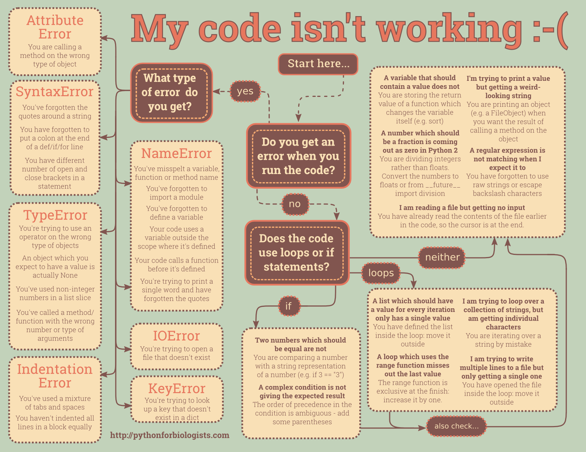

Slide 13
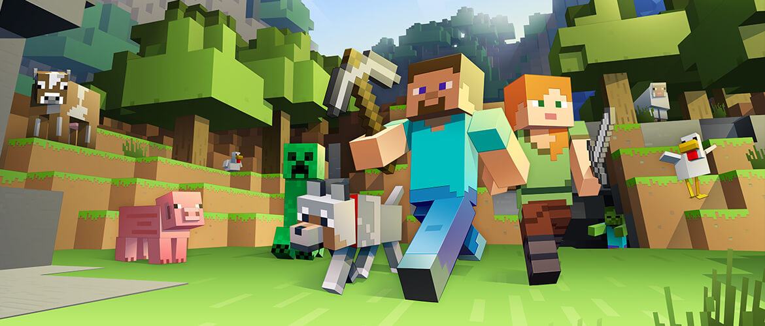
Today’s Problems!
Today’s problems are inspired by the popular video game Minecraft. The problems (but not solutions) are on the prelim slides.

Slide 14


Minecraft! Part 1 (Group Work)
Get your pickaxes ready..
We’re going to choose a location in Minecraft and dig down to see what ore we can find!
You’ll need:
• minecraft-mining-starter.py
• minecraft.py (module)
• mining_list.txt

Slide 15
Minecraft! Part 1 (Group Work)
Find materials:
Using try/except, read in the file mining_list.txt as a list
Make a mine so we can dig:
Call the function minecraft.create_mine, which (1) takes our mining materials list and (2) returns a list of random mining materials with a depth (length of list) of anywhere from 10 to 100 minerals
>>>
Materials found.
Mine created.
If you print the list:
['redstone\n', 'coal\n', 'stone\n', 'stone\n', 'dirt\n', 'stone\n', 'iron\n', 'dirt\n', 'stone\n', 'diamond\n', 'stone\n', 'coal\n', 'iron\n', 'coal\n', 'stone\n', 'dirt\n', 'dirt\n', 'stone\n', 'dirt\n', 'iron\n', 'dirt\n', 'coal\n', 'stone\n', 'coal\n', 'dirt\n', etc….

Slide 16

Minecraft!
Excellent!
Now that we’ve found a location to mine, let’s dig down and get some ore!
If we’re lucky, we’ll get rare items like gold, diamonds and obsidian, and avoid being burned by lava.

Slide 17

Minecraft! Part 2 (Group Work)
>>>
Materials found.
Mine created.
How deep would you like to dig? 5
Please choose a depth between 10 and 100.
>>>
Materials found.
Mine created.
How deep would you like to dig? wombat
Try again. You did not enter a number.
>>>
Materials found.
Mine created.
How deep would you like to dig? 10
Dig up minerals.
Write a function dig that takes the list generated by create_mine and returns a dictionary of materials found and a count for each.
Ask the user how deep to dig.
Return {} if not true:
The value is not between 10 & 100
The value is not a number Use try/except to catch this error. Be specific about the type.

Slide 18
Minecraft! Part 2 (Group Work)
Dig! Don’t hit lava!
Create a for loop that “digs” each item (adds it to our dictionary).
If the index is out of range, catch the error, return {}
Print out the minerals you’re digging up as you go!
Return the dictionary.
Example output from dig(): {'dirt': 3, 'sand': 1, 'coal': 1, 'stone': 1, 'sandstone': 2, 'gravel': 2}
>>>
How deep would you like to dig? 100
You found stone!
You found stone!
You found gravel!
Etc..
>>>
How deep would you like to dig? 100
You found iron!
You found dirt!
Etc…
YOU HIT LAVA!
All of your materials were destroyed.
You died.

Slide 19

Minecraft!
What? You didn’t burn up in the lava?
Fine, fine, so let’s look through what we found
Did we find anything valuable? Perhaps rare items like gold, diamonds or obsidian?

Slide 20
Minecraft! Part 3 (Group Work)
Look at our ore!
If we found minerals in our dig:
Did we find obsidian, gold or diamonds? Print out one or more messages.
If we didn’t, say that we didn’t find anything of value.
>>>
How deep would you like to dig? 10
You found iron!
You found stone!
Etc…
You found nothing of great value.
>>>
How deep would you like to dig? 10
You found iron!
You found stone!
Etc…
Excellent, you found 1 diamonds!
Eureka, you found 3 gold!
YES! You found the rarest mineral, obsidian!
(not all messages will print each time)

Slide 21
Minecraft! Bonus (Group Work)
Q: What happens if the user enters a float instead of an integer for how deep to dig?
→ Explain to your AI what happens if you enter a float value, and what you’d likely need to do to fix this issue.

Slide 22
Minecraft! Bonus (Group Work)
Q: What happens if you enter a float instead of an integer for the depth?
A: Our program will break with a TypeError when we “dig up” each element in our for loop within dig().
To fix this, we’d have to catch the TypeError as well as the NameError.

Slide 23
Minecraft (Solution)
import random
import minecraft
def dig(mine):
materials_found = {}
# part 2
try:
how_deep = eval(input("How deep would you like to dig? "))
if (how_deep < 10) or (how_deep > 100):
print("Please choose a depth between 10 and 100.")
return {}
except NameError:
print("Try again. You did not enter a number.")
return {}

Slide 24
Minecraft (Solution)
else:
for i in range(how_deep):
try:
item = mine[i].strip()
except IndexError:
print("\nYOU HIT LAVA!”)
print(“All of your materials were destroyed.")
print("You died.")
return {}
else:
print("You found", item + "!")
if item in materials_found:
materials_found[item] += 1
else:
materials_found[item] = 1
return(materials_found)

Slide 25
Minecraft (Solution)
## main
# part 1
try:
file = open("mining_list.txt", "r")
materials = file.readlines()
file.close()
except:
print("Materials not found.")
else:
print("Materials found.")
my_mine = minecraft.create_mine(materials)
#part 2
minerals = dig(my_mine)

Slide 26
Minecraft (Solution)
# part 3
if minerals:
if "gold" in minerals or "obsidian" in minerals or "diamond" in minerals:
if "gold" in minerals:
print("Eureka, you found", minerals["gold"], "gold!")
if "obsidian" in minerals:
print("YES! You found the rarest mineral, obsidian!")
if "diamond" in minerals:
print("Excellent, you found", minerals["diamond"], "diamonds!")
else:
print("You found nothing of great value.")

Slide 27
Questions?

Slide 28
I210 Information Infrastructure
Lab 9

Slide 29

Topic
Today’s focus is objects.

Slide 30

Quick Review – Objects
Class definition & docstring
Constructor, with attributes
Class method
Instantiated object
Calling a method
Changing the value of an instance’s attribute
class Car(object):
"""A virtual race car"""
def __init__(self, make="BMW"):
self.miles = 0
self.make = make
def info(self):
print("This race car is a", self.make + ".")
print("It has", self.miles, "miles on it.")
# main
player1 = Car()
player1.info()
player1.miles = 1000
print(player1.miles)

Slide 31
Quick Review – Objects
class Car(object):
"""A virtual race car"""
def __init__(self, make="BMW"):
self.miles = 0
self.make = make
def __str__(self):
reply = "Car object\n"
reply += "Make: " + self.make + "\n"
reply += "Mileage: " + str(self.miles) + "\n"
return reply
def info(self):
print("This race car is a", self.make + ".")
print("It has", self.miles, "miles on it.")
# main
player1 = Car()
print(player1)
“to string” method

Slide 32
When to Use Objects?
So when should we create an object?
Do we need to make many copies of a unique data structure?
Will we need to have a set of functions that operate on that data?
(AIs / UIs share opinions on this)

Slide 33
Objective (Group Work)
Write just a class with a constructor for:
A playing card, which has a suit and a rank.
A container, which has a max capacity and a current capacity.
An academic course, which has a course number, number of credit hours, scheduled time, location, and instructor.
Instantiate an object from each class!

Slide 34
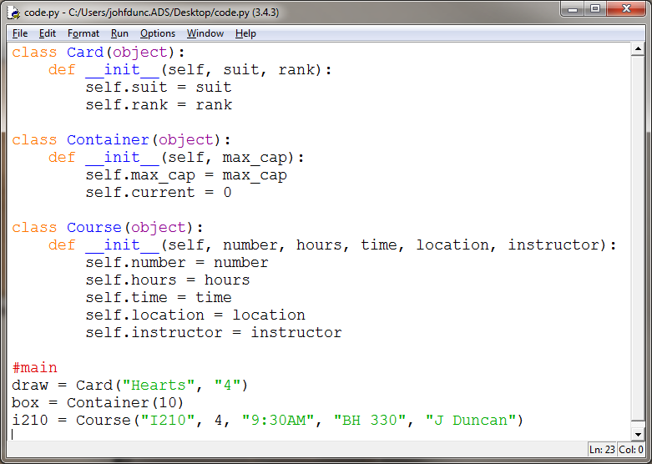
Objective (Solution)

Slide 35

Fighting Robots pt 1 (Group Work)
Write a class called Robot to model virtual fighting robots.
A Robot should have a name, a weapon, a strength rating, and start out as online (use a Boolean that starts out True!).
Print a message when a robot is created.
Implement a __str__ method that builds a string with the robot’s values as shown to the right.
Test code:
#main
r2d2 = Robot("R2D2", "Beeps", 2)
c3p0 = Robot("C3P0", "Conversation", 2)
print(r2d2)
print(c3p0)
Robot created! R2D2
Robot created! C3P0
--------------------
Fighting Robot
Name: R2D2
Weapon: Beeps
Strength: 2
Status: ONLINE
--------------------
--------------------
Fighting Robot
Name: C3P0
Weapon: Conversation
Strength: 2
Status: ONLINE
--------------------

Slide 36

Fighting Robots pt 1 (Solution)
class Robot(object):
def __init__(self, name, weapon, strength):
print("Robot created!", name, "\n")
self.name = name
self.weapon = weapon
self.strength = strength
self.online = True
def __str__(self):
reply = "-" * 20 + "\n"
reply += "Fighting Robot\n"
reply += "Name: " + self.name + "\n"
reply += "Weapon: " + self.weapon + "\n"
reply += "Strength: " + str(self.strength) + "\n"
if self.online:
reply += "Status: ONLINE\n"
else:
reply += "Status: OFFLINE\n"
reply += "-" * 20 + "\n"
return reply
#main
r2d2 = Robot("R2D2", "Beeps", 2)
c3p0 = Robot("C3P0", "Conversation", 2)
print(r2d2)
print(c3p0)
Robot created! R2D2
Robot created! C3P0
--------------------
Fighting Robot
Name: R2D2
Weapon: Beeps
Strength: 2
Status: ONLINE
--------------------
--------------------
Fighting Robot
Name: C3P0
Weapon: Conversation
Strength: 2
Status: ONLINE
--------------------

Slide 37
Fighting Robots pt 2 (Group Work)
Create a class attribute called robot_list that is a list of all robot objects currently in existence.
Make sure that when a robot is created, it adds itself to the robot_list.
Create a static method called contenders() that prints out all of the current robots, as well as how many total robots exist.
#main – test code for Part 2 ONLY:
Robot.contenders()
r2d2 = Robot("Optimus", "Fists", 10)
c3p0 = Robot("Voltron", "Sword", 10)
Robot.contenders()
There are 0 robots.
Robot created! Optimus
Robot created! Voltron
There are 2 robots.
Here is a list of them:
--------------------
Fighting Robot
Name: Optimus
Weapon: Fists
Strength: 10
Status: ONLINE
--------------------
--------------------
Fighting Robot
Name: Voltron
Weapon: Sword
Strength: 10
Status: ONLINE
--------------------

Slide 38


Fighting Robots pt 2 (Solution)
class Robot(object):
robot_list = []
@staticmethod
def contenders():
robots = len(Robot.robot_list)
print("There are", robots, "robots.\n")
if robots:
print("Here is a list of them:")
for robot in Robot.robot_list:
print(robot)
def __init__(self, name, weapon, strength):
print("Robot created!", name, "\n")
self.name = name
self.weapon = weapon
self.strength = strength
self.online = True
Robot.robot_list.append(self)
def __str__(self):
reply = "-" * 20 + "\n"
reply += "Fighting Robot\n"
reply += "Name: " + self.name + "\n"
reply += "Weapon: " + self.weapon + "\n"
reply += "Strength: " + str(self.strength) + "\n"
if self.online:
reply += "Status: ONLINE\n"
else:
reply += "Status: OFFLINE\n"
reply += "-" * 20 + "\n"
return reply
#main
Robot.contenders()
r2d2 = Robot("Optimus", "Fists", 10)
c3p0 = Robot("Voltron", "Sword", 10)
Robot.contenders()

Slide 39
I210 Information Infrastructure
Lab 9

Slide 40
More OOP Practice
Since there’s no new material, this lab is designed to be more review for LP3.
All 3 parts of today’s problem are on the prelim slides.

Slide 41

Fishing!
Let’s say we want to model virtual fishing.
(This guy’s enjoying this a bit too much)→
To do this, we’d need to model virtual fish!
We’ll build our code in 3 stages.

Slide 42

Fish (Group Work)
fish_starter.py on Canvas
Write a Fish class:
Attributes:
name (a string)
length (an int)
caught (a Boolean, starts off False)
Plus, don’t allow a fish that’s already caught to be caught again!
# test code for Part 1 ONLY
fish1 = Fish("Bass", 10)
fish2 = Fish("Goldfish", 2)
fish3 = Fish("Shark", 50)
print(fish3)
print(fish1.name, "is longer than", fish2.name, ":", fish1 > fish2)
print(fish1.name, "is longer than", fish3.name, ":", fish1 > fish3
fish1.catch()
fish1.catch()
Output:
Fish put in pond: Bass
Fish put in pond: Goldfish
Fish put in pond: Shark
Name: Shark
Length: 50"
Status: FREE
Bass is longer than Goldfish : True
Bass is longer than Shark : False
You attempt to catch Bass. Success!
Name: Bass
Length: 10"
Status: CAUGHT
You attempt to catch Bass. Bass was already caught!

Slide 43
Fish v2 (Group Work)
Fish put in pond: Bass
Fish put in pond: Goldfish
Fish put in pond: Shark
Number of fish in the pond: 3
Name: Bass
Length: 10"
Status: FREE
Name: Goldfish
Length: 2"
Status: FREE
Name: Shark
Length: 50"
Status: FREE
The largest fish is: Shark
You attempt to catch Bass. Success!
Name: Bass
Length: 10"
Status: CAUGHT
Number of fish in the pond: 2
Name: Goldfish
Length: 2"
Status: FREE
Name: Shark
Length: 50"
Status: FREE
Give the Fish class:
one class attribute
school (a list, initially empty)
two static methods
remaining() – prints the number of fish in the pond and their information
largest() – prints the name of the largest fish in the pond
# test code for Part 2 ONLY
fish1 = Fish("Bass", 10)
fish2 = Fish("Goldfish", 2)
fish3 = Fish("Shark", 50)
Fish.remaining()
Fish.largest()
fish1.catch()
Fish.remaining()

Slide 44
Fish v3 (Group Work)
Fish put in pond: 007
Fish put in pond: Grantham
Fish put in pond: Nemo
You attempt to catch 007. But it can't be done!!!
You attempt to catch Grantham. Success!
Name: Grantham
Length: 10"
Status: CAUGHT
What a rude thing to do to Lord Grantham !
You attempt to catch Nemo. Success!
Name: Nemo
Length: 3"
Status: CAUGHT
You attempt to release Nemo. Success!
Name: Nemo
Length: 3"
Status: FREE
You attempt to release Nemo. Nemo was already free!
Number of fish in the pond: 2
Name: 007
Length: 11"
Status: FREE
Name: Nemo
Length: 3"
Status: FREE
Create 3 child classes:
StealthFish – can’t be caught –> override the catch method!
FancyFish – in addition to a name, it has a title –> use super and override __init__ and catch!
NiceFish – implements a new method, release, that reverses the effects of catch – no other changes!
These inherit from Fish, like this: class StealthFish(Fish)
# test code for Part 3 Only
fish1 = StealthFish("007", 11)
fish2 = FancyFish("Lord","Grantham", 10)
fish3 = NiceFish("Nemo", 3)
fish1.catch()
fish2.catch()
fish3.catch()
fish3.release()
fish3.release()
Fish.remaining()

Slide 45
Fish (Solution)
class Fish(object):
def __init__(self, name, length):
print("Fish put in pond:", name, "\n")
self.name = name
self.length = length
self.caught = False
def __str__(self):
reply = "Name: " + self.name + "\n"
reply += "Length: " + str(self.length) + "\"\n"
if self.caught:
reply += "Status: CAUGHT\n"
else:
reply += "Status: FREE\n"
return reply
def __gt__(self, other):
if self.length > other.length:
return True
else:
return False
def catch(self):
print("You attempt to catch " + self.name + ".", end=' ')
if not self.caught:
print(”Success!")
self.caught = True
print(self)
else:
print(self.name, "was already caught!\n”)
#test code
fish1 = Fish("Bass", 10)
fish2 = Fish("Goldfish", 2)
fish3 = Fish("Shark", 50)
print(fish3)
print(fish1.name, "is longer than", fish2.name, ":", fish1 > fish2)
print(fish1.name, "is longer than", fish3.name, ":", fish1 > fish3
fish1.catch()
fish1.catch()

Slide 46
Fish v2 (Solution)
class Fish(object):
school = []
@staticmethod
def remaining():
print("Number of fish in the pond:", len(Fish.school))
for fish in Fish.school:
print(fish)
@staticmethod
def largest():
if len(Fish.school) > 0:
Fish.school.sort()
print("The largest fish is:", Fish.school[-1].name, "\n")
else:
print("No fish in pond.")
def __init__(self, name, length):
print("Fish put in pond:", name, "\n")
self.name = name
self.length = length
self.caught = False
Fish.school.append(self)
def __str__(self):
reply = "Name: " + self.name + "\n"
reply += "Length: " + str(self.length) + "\"\n"
if self.caught:
reply += "Status: CAUGHT\n"
else:
reply += "Status: FREE\n"
return reply
def __gt__(self, other):
if self.length > other.length:
return True
else:
return False
def catch(self):
print("You attempt to catch " + self.name + ".", end=' ')
if not self.caught:
print("Success!")
self.caught = True
print(self)
Fish.school.remove(self)
else:
print(self.name, "was already caught!\n")
#test code
fish1 = Fish("Bass", 10)
fish2 = Fish("Goldfish", 2)
fish3 = Fish("Shark", 50)
Fish.remaining()
Fish.largest()
fish1.catch()
Fish.remaining()

Slide 47
Fish v3 (Solution)
class StealthFish(Fish):
def catch(self):
print("You attempt to catch " + self.name + ".", end = ' ')
print("But it can't be done!!!\n")
class FancyFish(Fish):
def __init__(self, title, name, length):
super().__init__(name, length)
self.title = title
def catch(self):
super().catch()
print("What a rude thing to do to", self.title, self.name, "!\n")
class NiceFish(Fish):
def release(self):
print("You attempt to release " + self.name + ".", end = ' ')
if self.caught:
print("Success!")
self.caught = False
print(self)
Fish.school.append(self)
else:
print(self.name, "was already free!\n")

Slide 48
Full Solution
class Fish(object):
school = []
@staticmethod
def remaining():
print("Number of fish in the pond:", len(Fish.school))
for fish in Fish.school:
print(fish)
@staticmethod
def largest():
if len(Fish.school) > 0:
Fish.school.sort()
print("The largest fish is:", Fish.school[-1].name, "\n")
else:
print("No fish in pond.")
def __init__(self, name, length):
print("Fish put in pond:", name, "\n")
self.name = name
self.length = length
self.caught = False
Fish.school.append(self)
def __str__(self):
reply = "Name: " + self.name + "\n"
reply += "Length: " + str(self.length) + "\"\n"
if self.caught:
reply += "Status: CAUGHT\n"
else:
reply += "Status: FREE\n"
return reply
def __gt__(self, other):
if self.length > other.length:
return True
else:
return False
def catch(self):
print("You attempt to catch " + self.name + ".", end=' ')
if not self.caught:
print("Success!")
self.caught = True
print(self)
Fish.school.remove(self)
else:
print(self.name, "was already caught!\n")
class StealthFish(Fish):
def catch(self):
print("You attempt to catch " + self.name + ".", end = ' ')
print("But it can't be done!!!\n")
class FancyFish(Fish):
def __init__(self, title, name, length):
super().__init__(name, length)
self.title = title
def catch(self):
super().catch()
print("What a rude thing to do to", self.title, self.name, "!\n")
class NiceFish(Fish):
def release(self):
print("You attempt to release " + self.name + ".", end = ' ')
if self.caught:
print("Success!")
self.caught = False
print(self)
Fish.school.append(self)
else:
print(self.name, "was already free!\n")
#test code
fish1 = StealthFish("007", 11)
fish2 = FancyFish("Lord","Grantham", 10)
fish3 = NiceFish("Nemo", 3)
fish1.catch()
fish2.catch()
fish3.catch()
fish3.release()
fish3.release()
Fish.remaining()

